Slide 1

Project Proposal
Should You Mask 15% in Masked Language Modeling?
Katharina Strauss Soegaard
Aaron Lingchi Chao
Timo Stephan Hermann Stoll
Max Huppertz
Notes:
Max

Slide 2
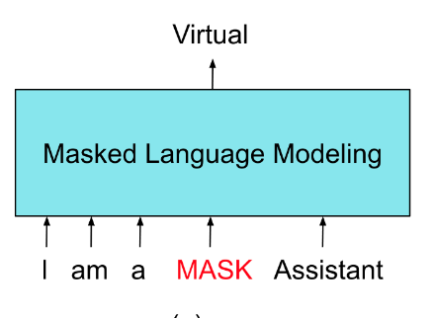
Problem
Masking rate - 15%
Masking strategy
Fig. https://miro.medium.com/v2/resize:fit:880/1*0vMq-b5y1-XoA4TGJ3Akew.png
Notes:
Max
What is the topic of your paper? What is the specific task being tackled? Why is it important to solve this problem?
Masked language modeling predicts a masked token in a sequence
Bert is a good bidirectional example
Mysterious 15% masking rate -> fear of insufficient context
PMI (Pointwise Mutual Information) based on highest dependency , span (span of tokens), uniform

Slide 3
Problem
“15% masking is used ubiquitously by BERT’s successors”
BUT
“15% is not universally optimal“
Which impact do masking rate and strategy have?
https://aclanthology.org/2023.eacl-main.217.pdf
Notes:
Max
What is the topic of your paper? What is the specific task being tackled? Why is it important to solve this problem?

Slide 4
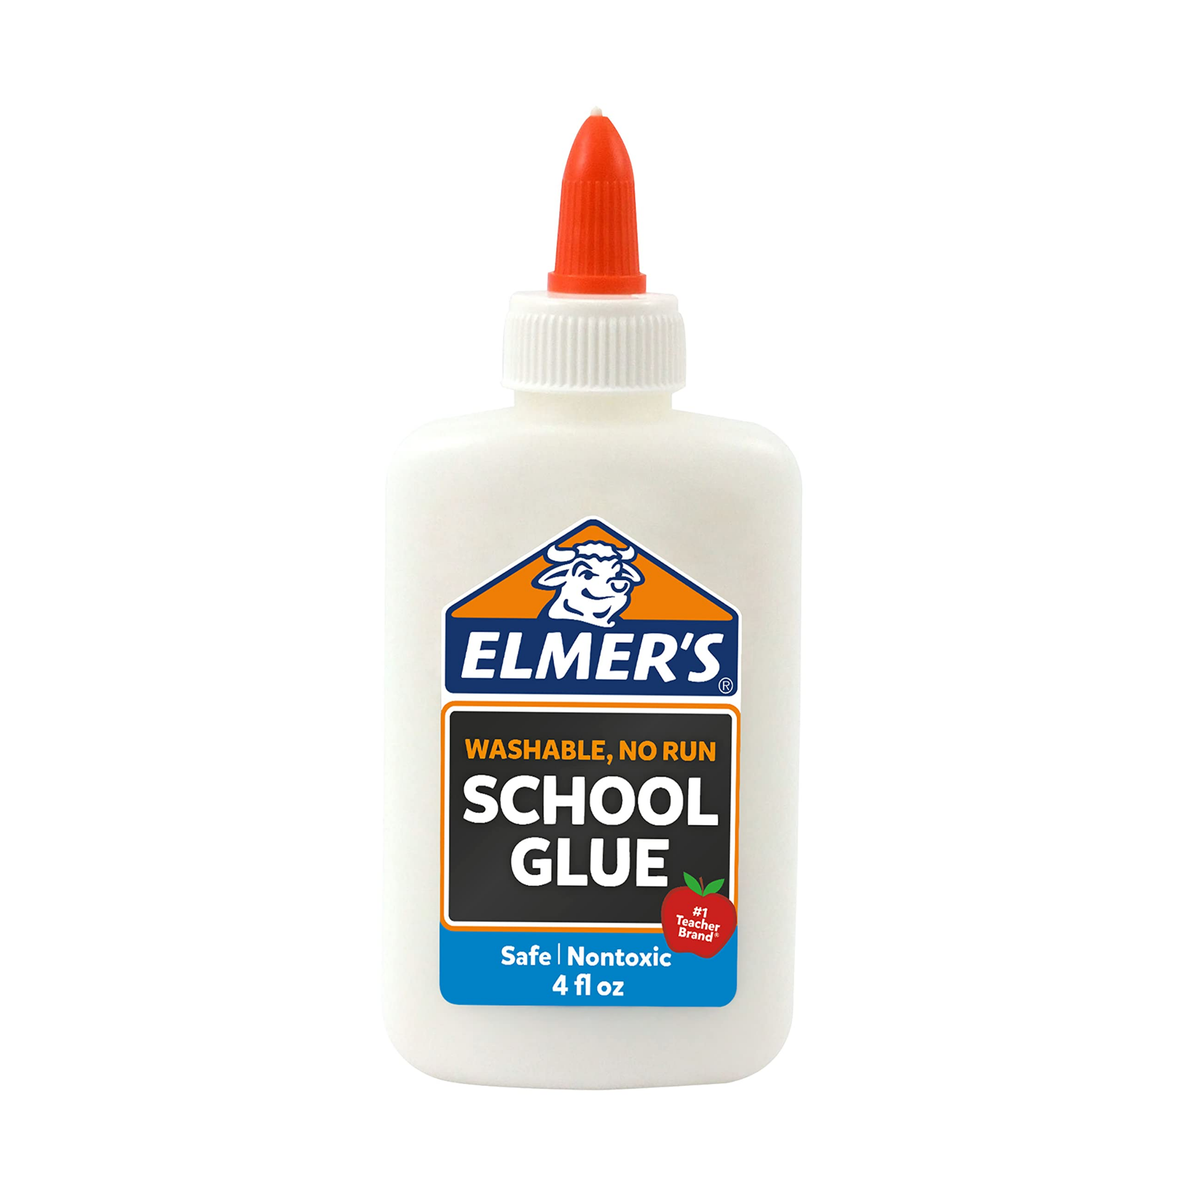
Problem - Importance
Masking rate and strategy effect:
Performance on downstream tasks (GLUE)
Sample efficiency
Training time
Masking rate and strategy choice is important!
Notes:
Max
What is the topic of your paper? What is the specific task being tackled? Why is it important to solve this problem?
Downstream task: applying the pre-trained model‘s knowledge to a new problem
The amount of labeled data required by an algorithm

Slide 5
Related Work
Masking strategies
Span masking (Joshi et al., 2020; Raffel et al., 2020)
PMI masking (Levine et al., 2021)
Probabilistic masking (Liao et al., 2020)
Influence on intermediate pre-training (Ye et al., 2021)
Notes:
Max

Slide 6
Related Work cont.
Unrealistic MLM training
Shuffled word order (Sinha et al., 2021)
Randomly generated sequences (Krishna et al., 2021)
Other language models
Autoregressive language models (Radford et al., 2018; Brown et al., 2020)
Sequence-to-sequence (Raffel et al., 2020; Lewis et al., 2020)
Masking in video and image

Slide 7
Replication Approach
Thesis: A 15% Constant Masking Rate is not ideal for all models.
Conclusion: Larger models can benefit from higher masking rates.
Interesting Insights from the Study:
1. Even high masking rates can still train models with good performance
2. BERT’s Masking Strategy: even split between same token predictions [MASK] and random token corruptions {random} were found to be worse in the researchers’ tests compared to solely using [MASK]
Provided: Code and Instructions on how to format data on GitHub
Notes:
Pretrained model
Aaron
Interesting Insights from the Study: 1. Different masking rates are better depending on the size of the model 2. Originally, BERT’s masking with 10% [MASK] tokens (same token predictions) & 10% replacement with random tokens (random token corruptions) was recommended, but the paper found that the performance was actually worse than just directly masking with only [MASK] tokens

Slide 8
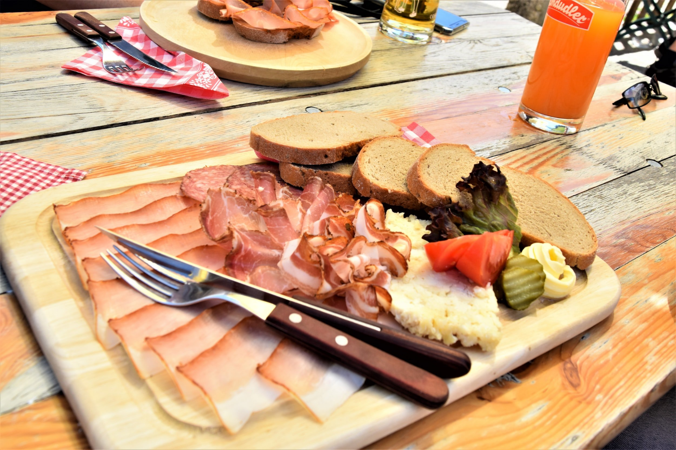

Improvement
We wish to expand this research to the German language
Train smaller models first and then larger models if possible
Train from scratch with German corpus
Alternate masking rates while training
Notes:
Katharina
Adapt the method for the german corpus
Train from scratch
Smaller models at first
is it possible to alternate masking rates while training, and how would that affect performance?
german language corpus
adaptive masking rate

Slide 9
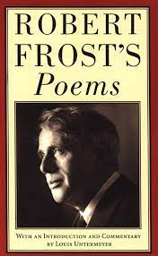


Extra Ideas for Improvement
Use other libraries like ELECTRA as suggested in the paper
Compare masking rate performance with datasets of specific fields
https://huggingface.co/docs/transformers/model_doc/electra
Notes:
compare masking rate performance with datasets of specific fields, ie academic, poetry vs literature, online communities
their suggestion of using other libraries like electra

Slide 10

Data
Training datasets for masking:
Wikipedia: Collection of german wikipedia articles
OSCAR: Common crawl dataset of german language texts
Benchmark datasets for evaluation:
GermEval2018: Text classification task based on german tweets
10kGNAD: Text classification of german news articles
GermEval2014: Named Entity Recognition task using Wikipedia and news articles
Notes:
Timo
Wikipedia: https://huggingface.co/datasets/wikipedia
OSCAR: https://oscar-project.org/
GermEval2018: https://github.com/uds-lsv/GermEval-2018-Data
10kGNAD: https://tblock.github.io/10kGNAD/
GermEval2014: https://huggingface.co/datasets/germeval_14

Slide 11
Timeline
Week # | Tasks
9-10 | Run Original Code and Replicate Results
11 | Upload Replication Presentation Video
12 | Figure out the Improvement Implementation (i.e. New Dataset)
13-14 | Get Results from Changed Implementation and Write Report
15 | Final Presentation (12/5-12/7)
16 | Final Report (12/14)
Notes:
Aaron

Slide 12
Citations
Wettig, Alexander, et al. Should You Mask 15% in Masked Language Modeling? - ACL Anthology, Association for Computational Linguistics, May 2023, aclanthology.org/2023.eacl-main.217.pdf.
Notes:
Aaron (you don’t have to say something I guess)

Slide 13



Questions
Notes:
Aaron

